Slide 1

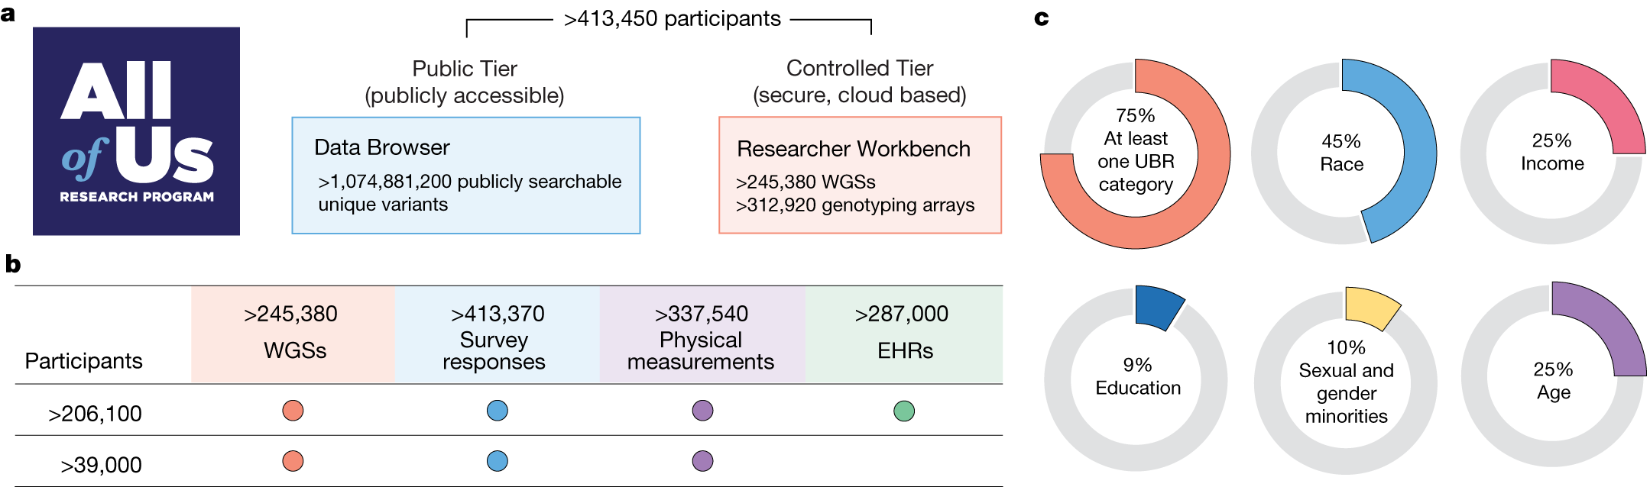
Genomic data in the All of Us Research Program
QBC Journal Club Presentation
Wanjun Gu

Slide 2
Overview of the AllofUs database

Slide 3
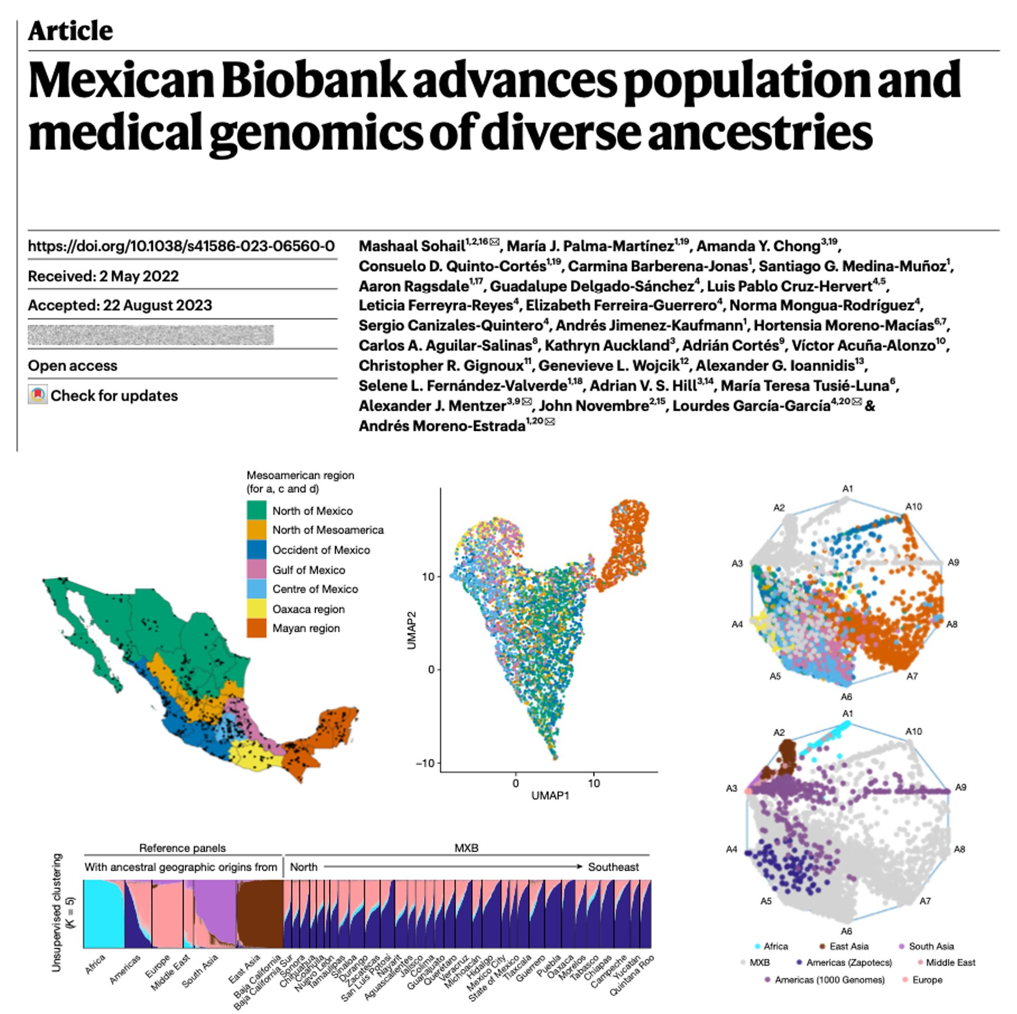



Why Biobanks

Slide 4
Why Biobanks
All Biobanks:
Resource for Genetic Material
- Ancestrally diverse reference panel
Accelerating Medical Research and Advancing Personalized Medicine
- Electronic Health Records (EHR) and genetics data
- Bridging Clinical and Research Data
Enabling Reproducibility and Validation
- Supporting Diverse Studies
Promoting Global Collaboration

Slide 5
The AllofUs Biobank
Why AllofUs?
Promoting collaboration between different sites in the states.
Centralized management of EHR and genetic information
Genetic reference panel that is representative of the demographic of the united states.

Slide 6
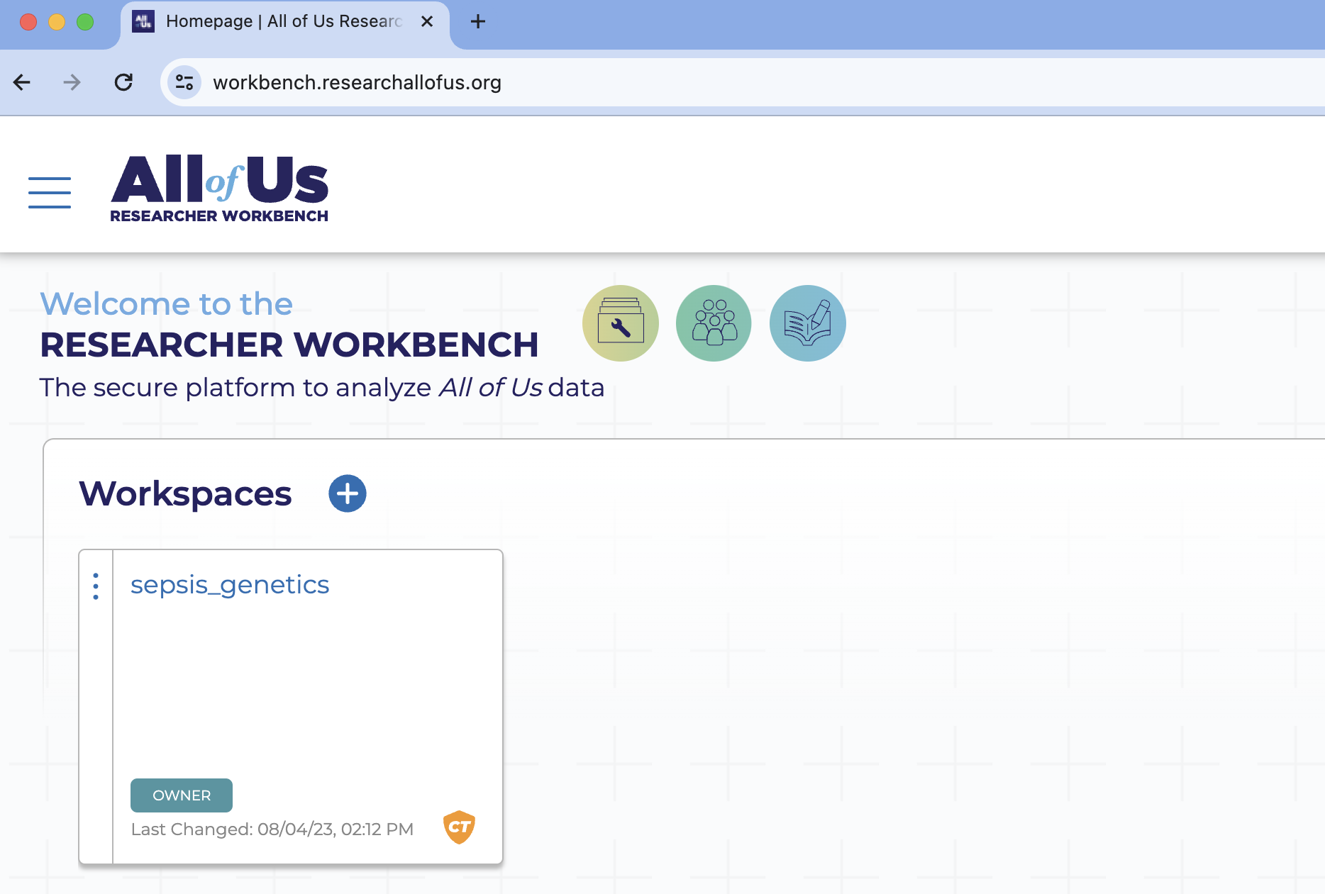
The AllofUs biobank has rich phenotype data and is made easy to use
The All of Us Research Hub
Rich phenotype data:
Physical measurements
Survey responses
EHRs
Wearables
Genomic data

Slide 7
AllofUs recruits subjects from diverse backgrounds
99% of participants:
WGS data + survey data + physical measurements
84% also have EHR data.
77% of individuals:
identify with groups historically under-represented in biomedical research
Among them, 46% who self-identify with a racial or ethnic minority group

Slide 8
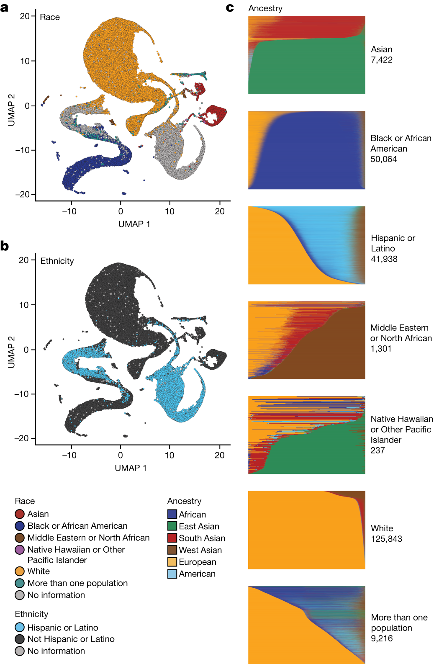
Ancestral breakdown of AllofUs

Slide 9
Ancestral breakdown of AllofUs
Uniform manifold approximation and projection (UMAP) representations of All of Us WGS PCA data with self-described race (a) and ethnicity (b) labels.

Slide 10
Admixture Analysis reveals diverse genetic ancestries
Admixture plots:
Each horizontal bar:
one individual
Colors on the x axis:
subject ancestry breakdown
Ancestry components are generated based on unsupervised clustering
Notes:
Defining the admixture plot a bit better/ more here for people’s context
Each column
Each color
Etc.

Slide 11
Admixture Analysis reveals diverse genetic ancestries
Proportion of genetic ancestry per individual across 6 distinct and coherent ancestry groups
Notes:
Defining the admixture plot a bit better/ more here for people’s context
Each column
Each color
Etc.

Slide 12
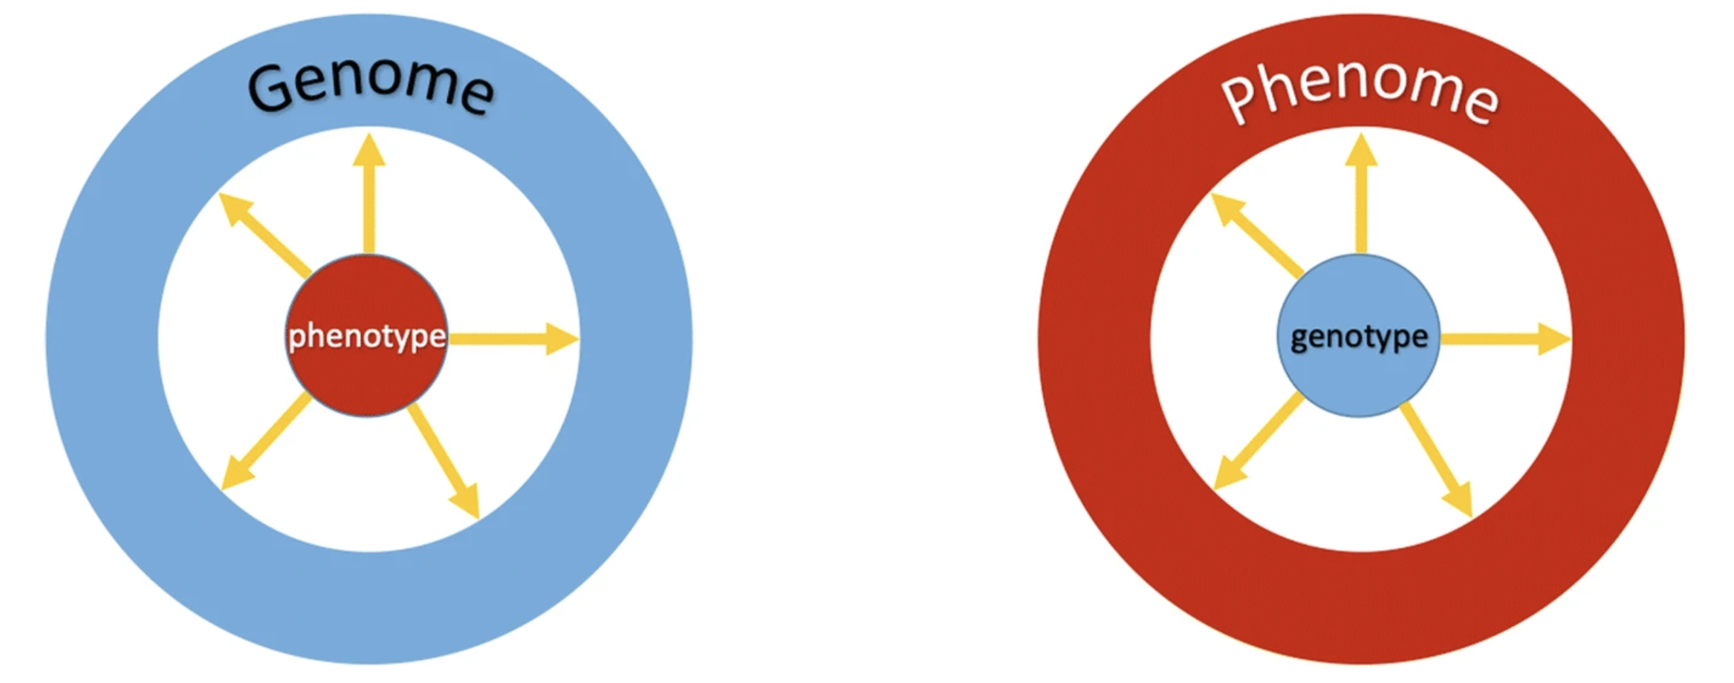
Genotype-phenotype correlation analysis frameworks
GWAS
PheWAS
Locus
(1,..,n)
Trait 1
Trait 1
Locus
(1,..,n)
Locus
(1,..,n)
Trait 2
Trait 2
GWAS Framework
PheWAS Framework
Notes:
One to one
Multivaraite: many to one
Add the introduction of the phewas framework using diagrams

Slide 13
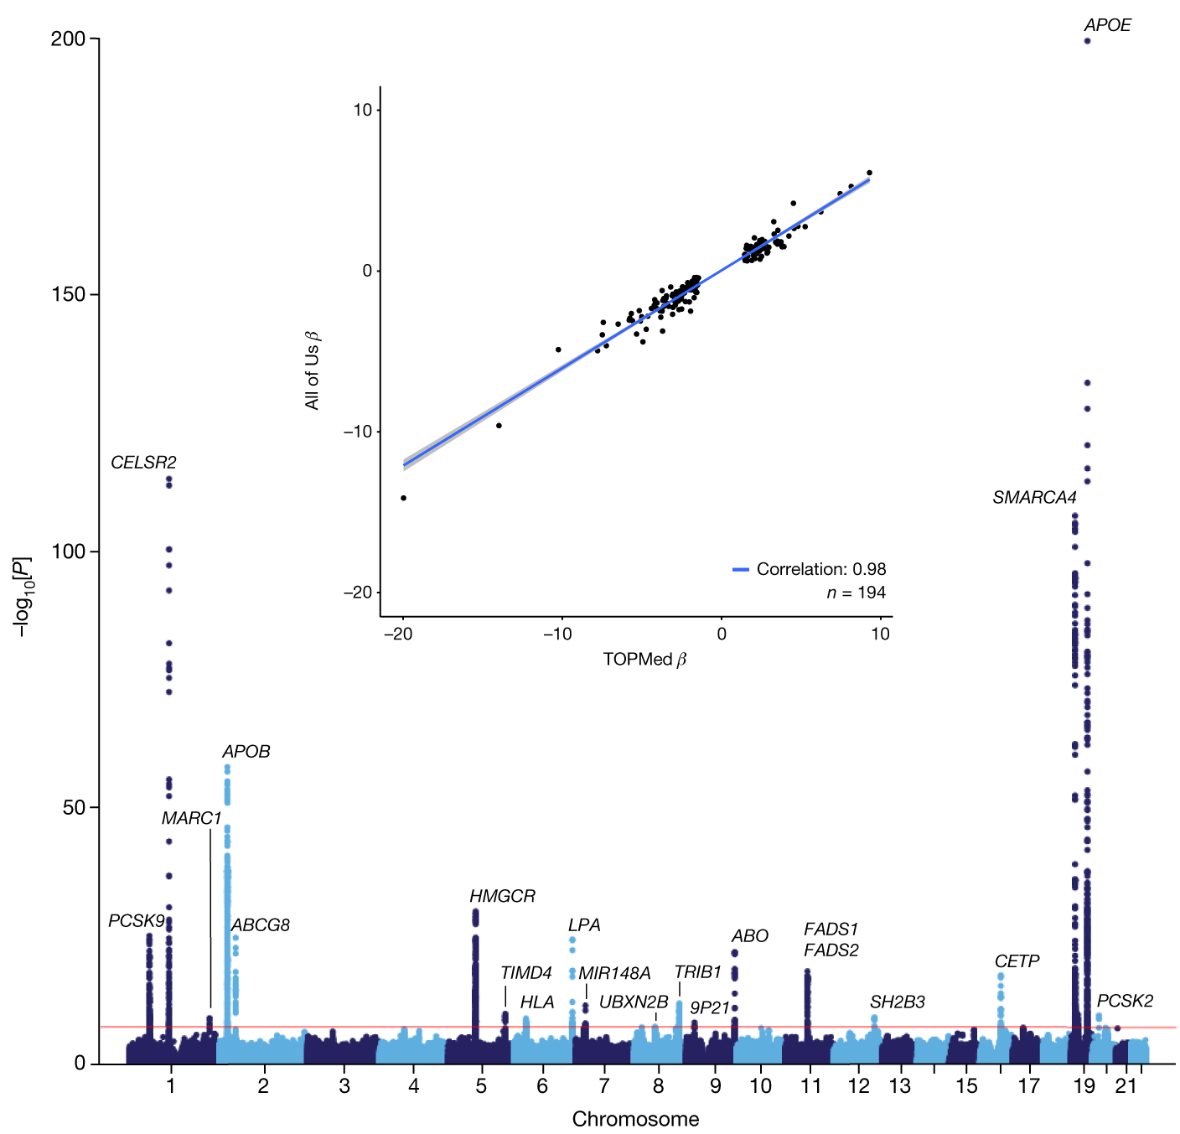
Genetic Architecture of LDL-C (GWAS on LDL-C)
Why LDL-C:
40-50% heritable
Less complex genetic architecture than traits such as height or BMI
More complex than Mandelian traits such as sickle cell anemia or freckles
Extensively studied (good for validation)

Slide 14
Genetic architecture of LDL-C validated in AllofUs
Manhattan plot shows:
Robust replication of 20 well-established LDL-C genetic loci among 91,749 individuals with 1 or more LDL-C measurements.
Notes:
Why LDL
0. Enable us to map the genetic architecture of phenotypic measurements
Common measurement
Not too complex (height)
Not too Mendelian (sickle cell anemia)
Good as a positive control
Explain the genetic architecture (frequency + commonness of the disease plot)
Genetic architecture is sometimes not the same across the population

Slide 15
Effect size estimate (β) comparison:
X-axis: NHLBI TOPMed LDL-C GWAS Y-axis: All of Us LDL-C GWAS
194 independent variants that reached genome-wide significance in NHLBI TOPMed.
(window size: 250 kb; r2: 0.5)

Slide 16
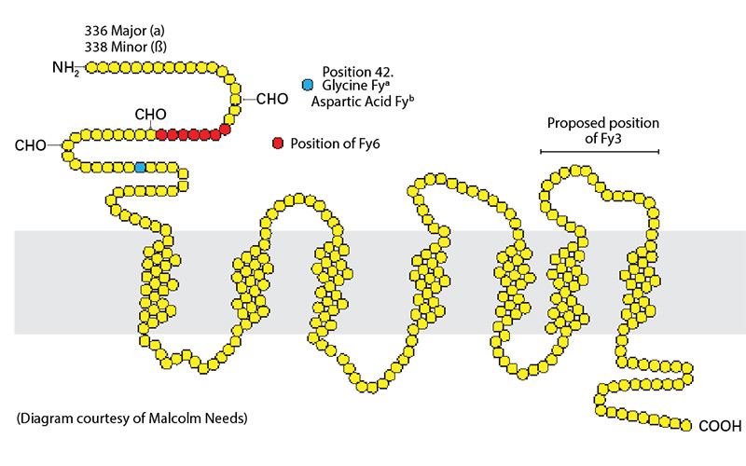
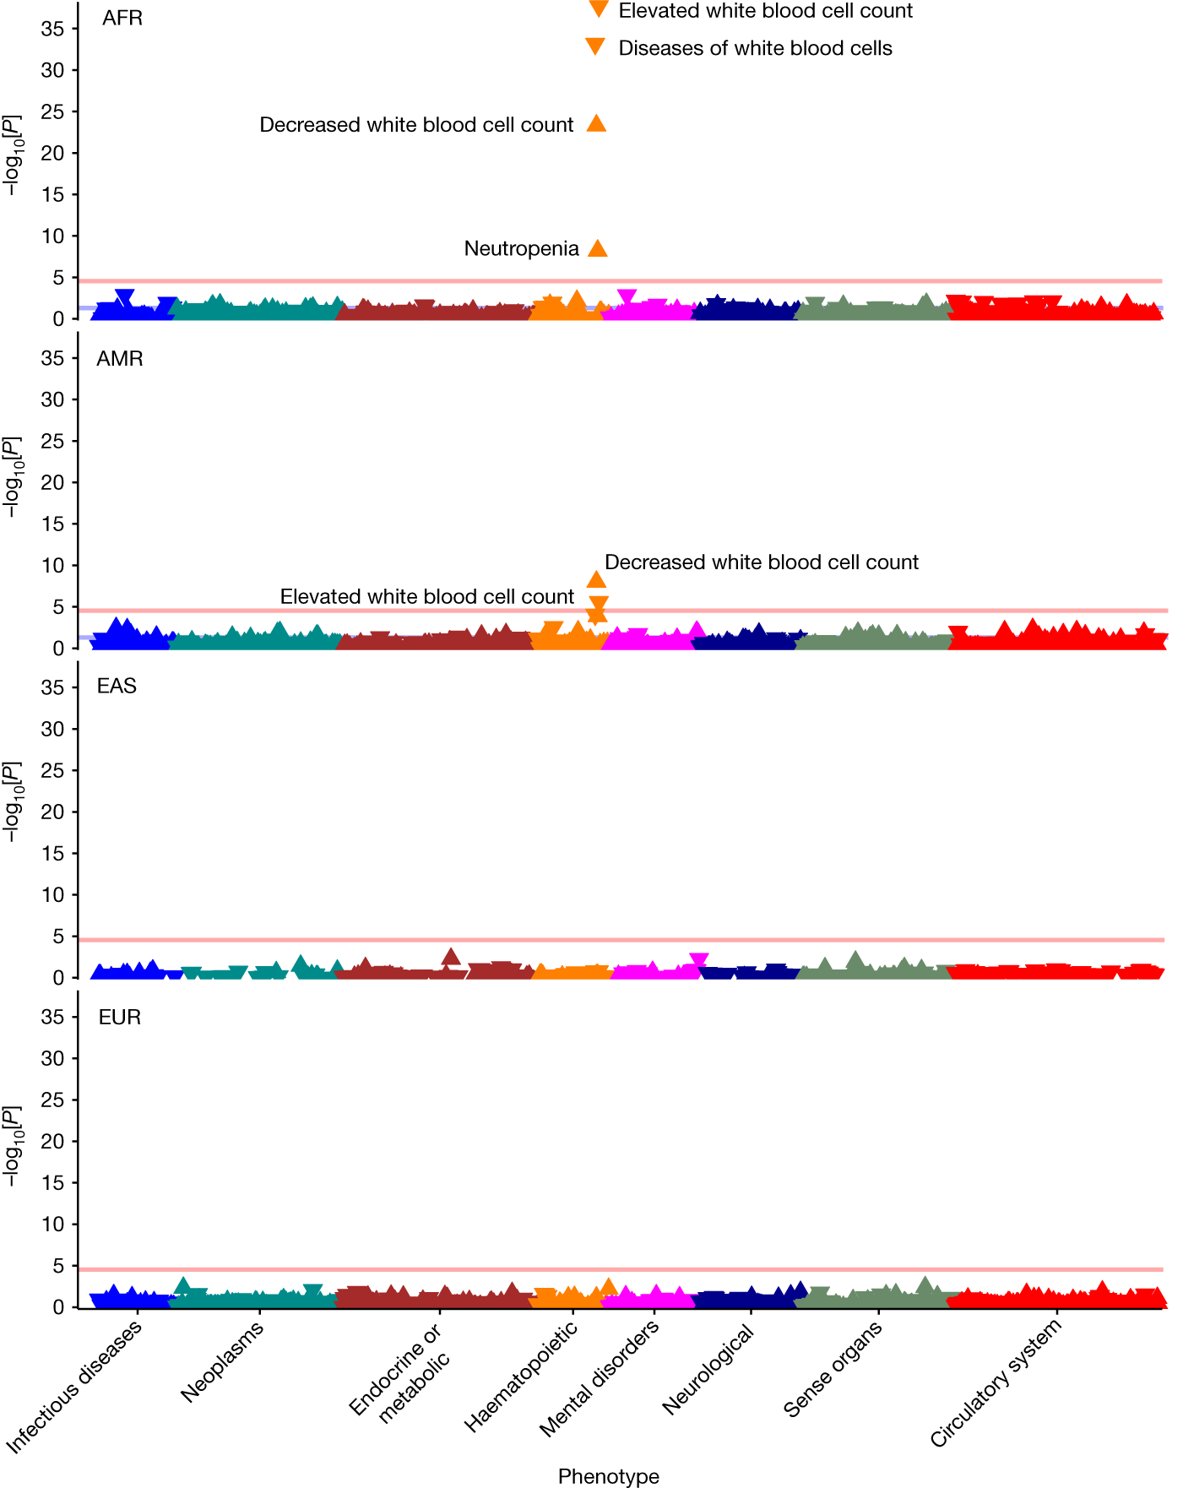
PheWAS on the Duffy blood group locus
The Duffy blood group system
A complex of highly immunogenic glycoprotein antigens found on the surface of red blood cells (RBC), vasculature endothelial cells, alveolar epithelial cells, collecting tubules of the kidney, and on the surface of Purkinje cells in the brain.
Notes:
Slides that graphically introduces the GWAS and PheWAS.
Put the locus name and coordinates in there
Animate the significant loci (associations) as I go through with the slides.
Phenome-wide associations of the Duffy blood group locus (rs2814778, ACKR1).
The Duffy blood group system is a complex of highly immunogenic glycoprotein antigens found on the surface of red blood cells (RBC), vasculature endothelial cells, alveolar epithelial cells, collecting tubules of the kidney, and on the surface of Purkinje cells in the brain.

Slide 17
Genotype-by-phenotype associations
Phenome-wide associations of the Duffy blood group locus (rs2814778, ACKR1).
AFR (n = 34,037, MAF = 0.82)
AMR (n = 28,901, MAF = 0.10)
EAS (n = 32,55, MAF = 0.003)
EUR (n = 101,613, MAF = 0.007).
Strong associations with hematological phenotypes are observed, reassuringly.
Notes:
Slides that graphically introduces the GWAS and PheWAS.
Put the locus name and coordinates in there
Animate the significant loci (associations) as I go through with the slides.
Phenome-wide associations of the Duffy blood group locus (rs2814778, ACKR1).
The Duffy blood group system is a complex of highly immunogenic glycoprotein antigens found on the surface of red blood cells (RBC), vasculature endothelial cells, alveolar epithelial cells, collecting tubules of the kidney, and on the surface of Purkinje cells in the brain.

Slide 18
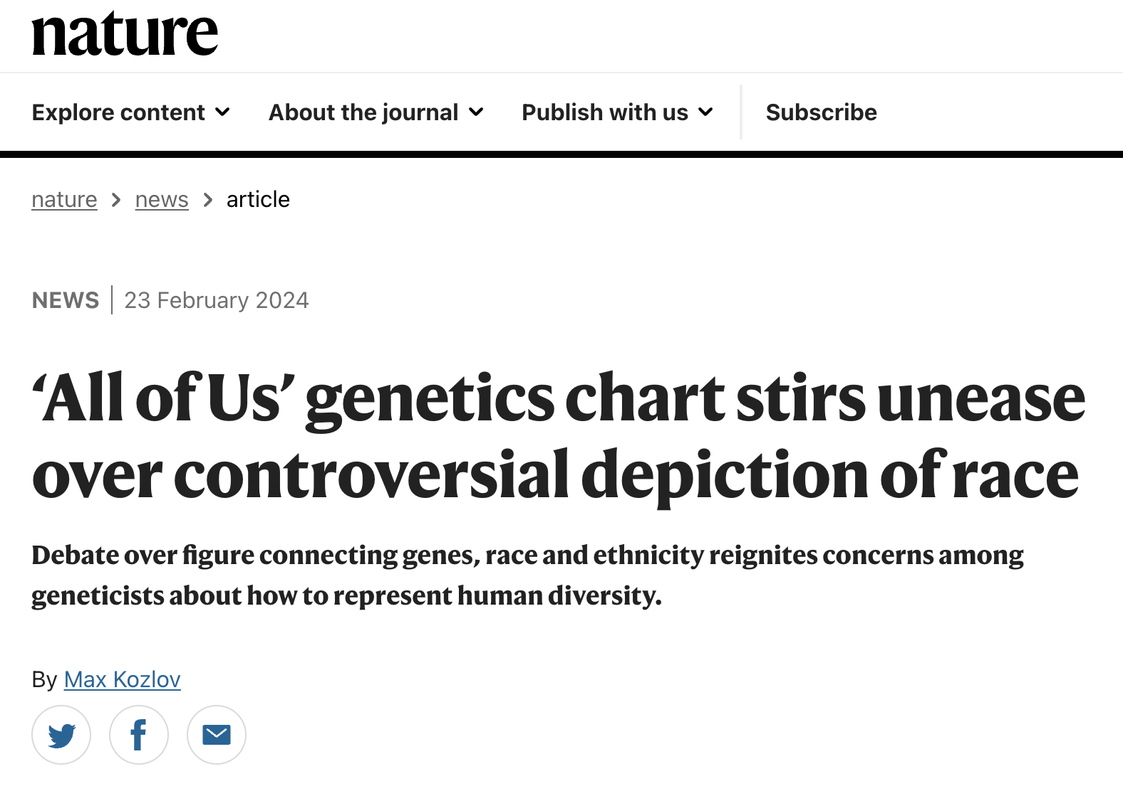
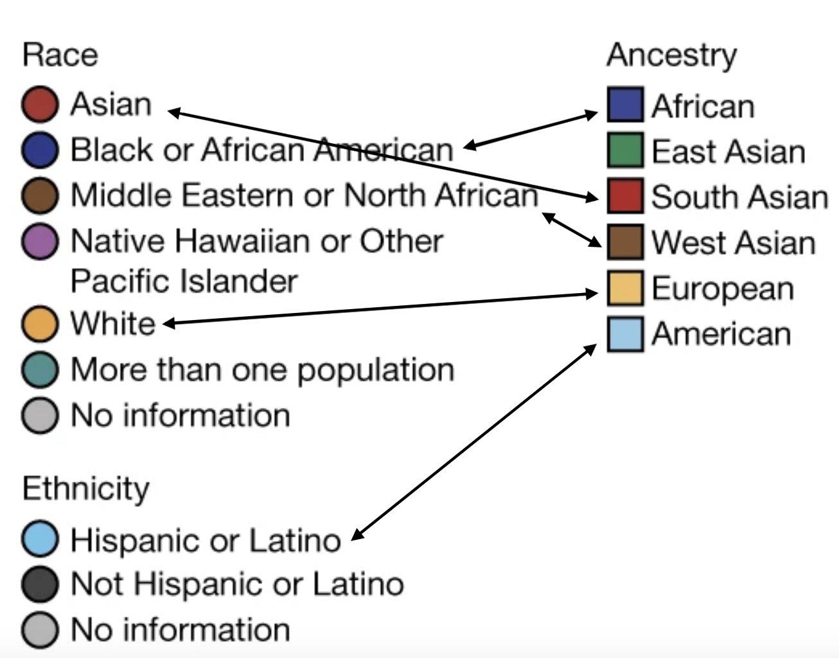
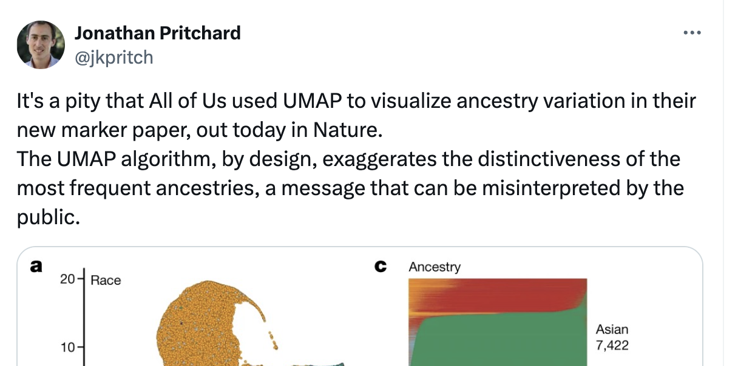
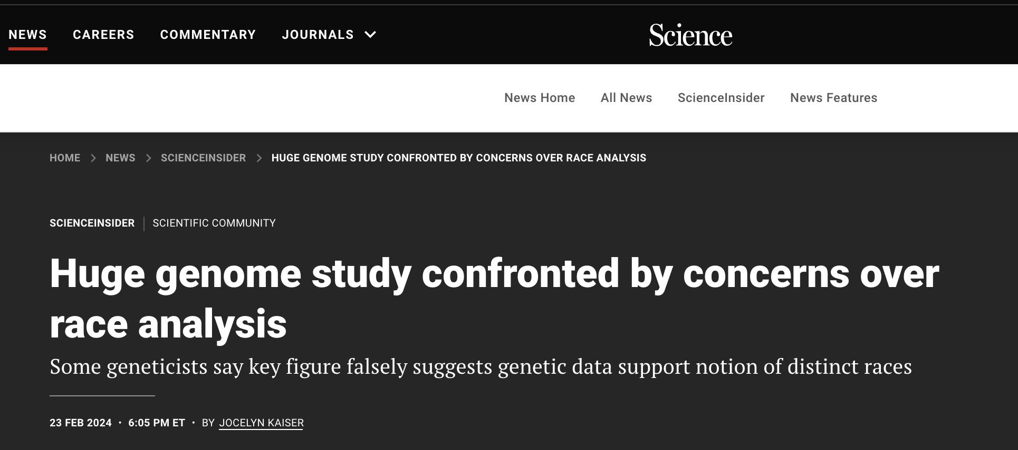
Controversies of the AllofUs genetic diversity representation

Slide 19
AllofUs has inaccurate representation of race, ethnicity and ancestry
Race is a social classification based on physical characteristics
Ethnicity refers to cultural identity and heritage
Genetic ancestry is the lineage traced through one's DNA.
Notes:
Definition of race, ethnicity and genetic ancestry
What are those terms? What do these terms mean
Race is a social classification based on physical characteristics, ethnicity refers to cultural identity and heritage, and genetic ancestry is the lineage traced through one's DNA.

Slide 20
AllofUs has inaccurate representation of race, ethnicity and ancestry
No clear-cut distinction between race and ethnicity
45.92% self-identified as a non-European race or ethnicity but none of the race categories are “European”, and “European” is also not an ethnicity category.
White = European?
Hispanic or Latino = American?
Notes:
Definition of race, ethnicity and genetic ancestry
What are those terms? What do these terms mean
Race is a social classification based on physical characteristics, ethnicity refers to cultural identity and heritage, and genetic ancestry is the lineage traced through one's DNA.

Slide 21
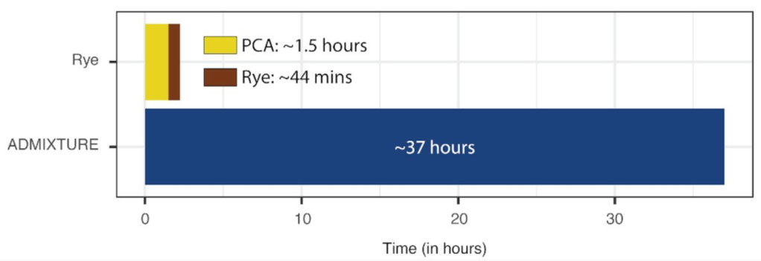
AllofUs has inaccurate representation of race, ethnicity and ancestry
Did not represent the sample size of people from each group
Used Rye instead of ADMIXTURE’
Rye is a lot faster, but its results differ significantly from outputs from ADMIXTURE

Slide 22
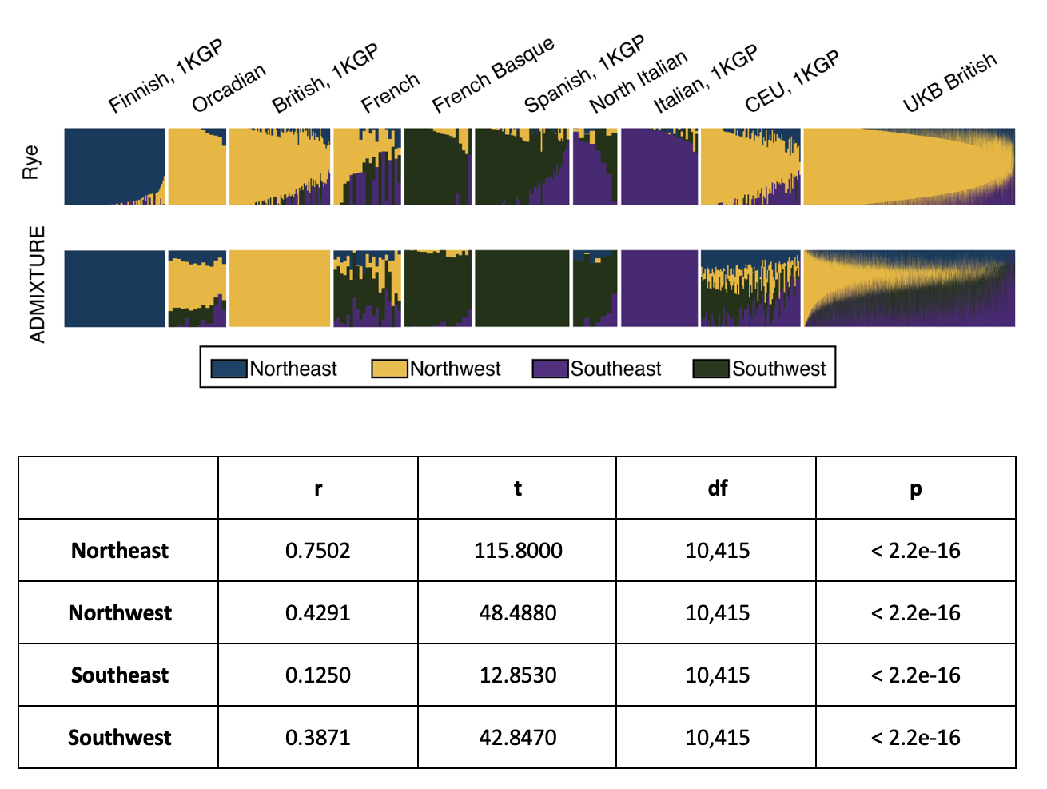
The admixture estimation of AllofUs is problematic
Rye results can be problematic
Phantom admixtures
Different admixture breakdown compared to ADMIXTURE

Slide 23
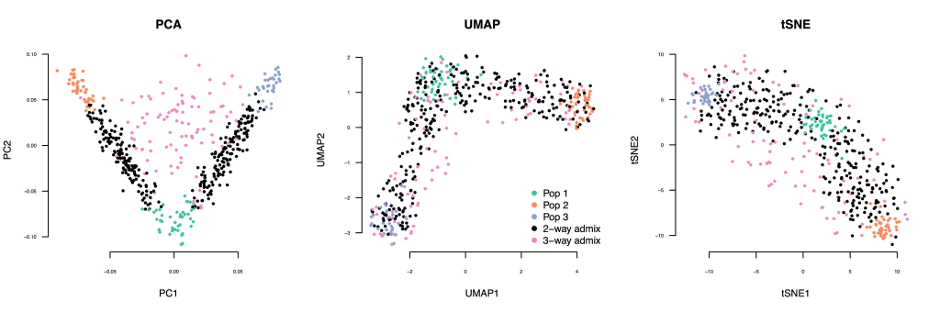
AllofUs UMAP visualization is flawed
Axes are not necessary – as UMAP distorts distance
UMAP is bad at representing admixture
Admixed population can collapse into major structures
Notes:
Enlarge the legends
Add a traditional pca plot as a reference

Slide 24
Discussion Questions
Do you think the AllofUs consortium did a good job representing the genetic diversity of the cohort?
Do you think presenting results that can potentially be misunderstood or taken advantage of by groups with certain political agenda is something the authors/reviewers should concern?
How would you present the AllofUs genetics data differently knowing the controversies associated with this manuscript?
Notes:
Underscore the great potential of the study

Slide 25


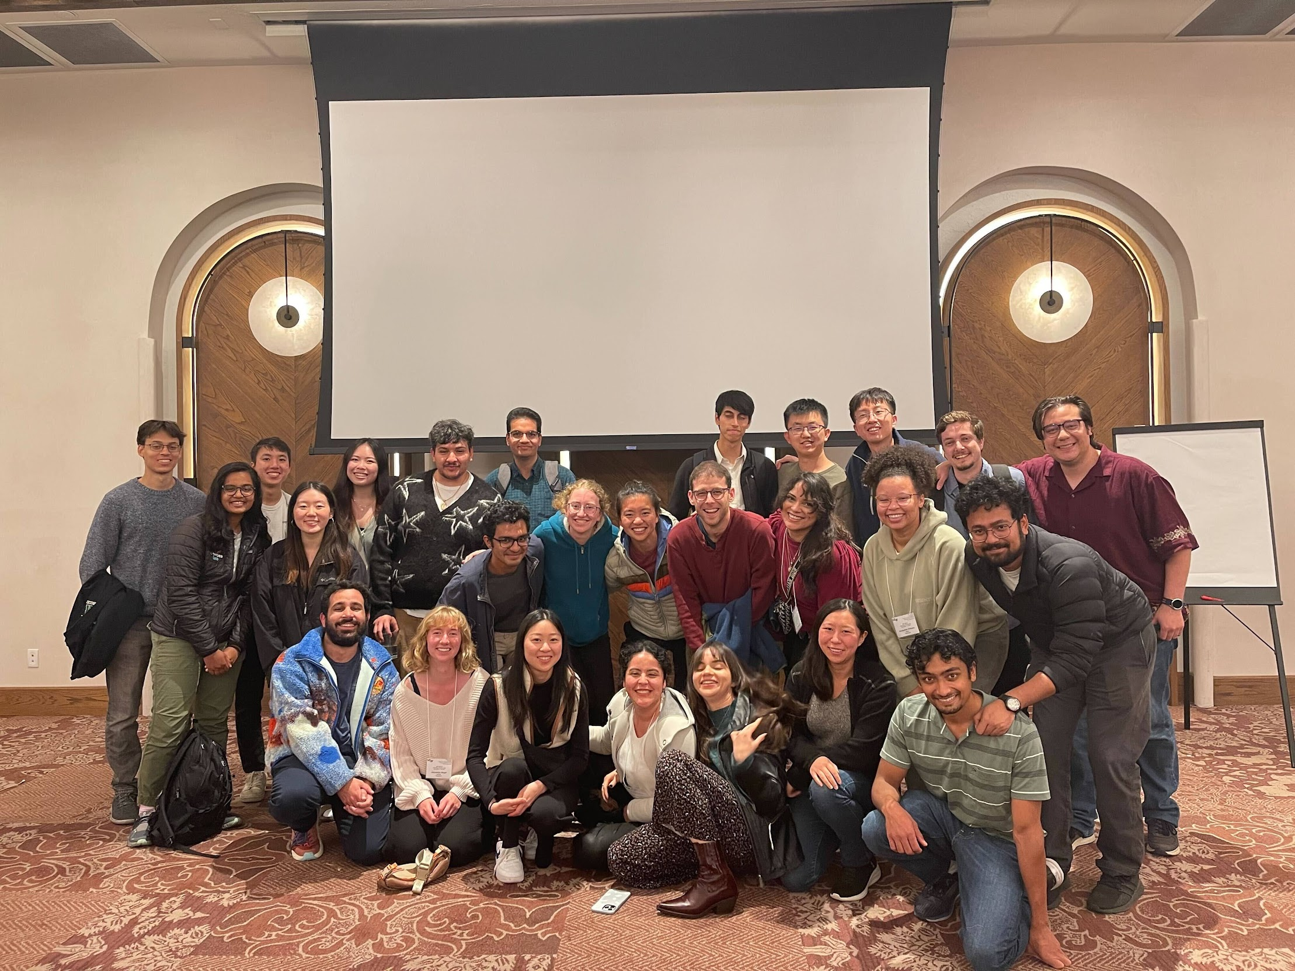

Acknowledgements
Dr. Sergio Baranzini
Dr. Tony Capra
References:
UCSF BMI
Notes:
Underscore the great potential of the study

Slide 26
References
All of Us Research Program Genomics Investigators. Genomic data in the All of Us Research Program. Nature (2024) doi:10.1038/s41586-023-06957-x
Pachter, L. All of Us failed. Bits of DNA https://liorpachter.wordpress.com/2024/02/26/all-of-us-failed/ (2024)
Kozlov, M. ‘All of Us’ genetics chart stirs unease over controversial depiction of race. Nature Publishing Group UK http://dx.doi.org/10.1038/d41586-024-00568-w (2024) doi:10.1038/d41586-024-00568-w
Race and National Origin. National Institutes of Health (NIH) https://www.nih.gov/nih-style-guide/race-national-origin (2022)
National Academies of Sciences, Engineering, and Medicine & Committee on the Use of Race, Ethnicity, and Ancestry as Population Descriptors in Genomics Research. Using Population Descriptors in Genetics and Genomics Research: A New Framework for an Evolving Field. (National Academies Press, 2023).
Conley, A. B. et al. Rye: genetic ancestry inference at biobank scale. Nucleic Acids Res. 51, e44 (2023)
Tweets of Sasha Gusev at https://twitter.com/SashaGusevPosts/status/1760156864229122428?s=20
Tweets of Lior Pachter at https://twitter.com/lpachter/status/1692310130229166172?s=20
Article in Science https://www.science.org/content/article/huge-genome-study-confronted-concerns-over-race-analysis
Link to references
Notes:
Underscore the great potential of the study

Slide 27
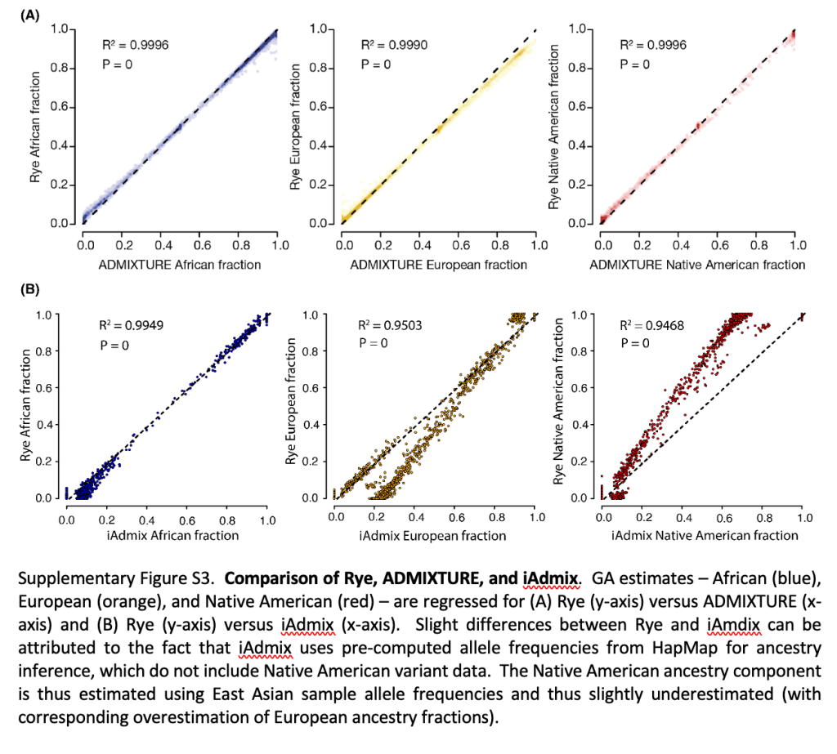
In the original Rye paper, R2 and p values are used to determine the performance of Rye compared to ADMIXTURE

